Slide 1
PROGRAMMING
LESSON INFOGRAPHICS
Here is where this template begins

Slide 2
CONTENTS OF THIS TEMPLATE
This template contains an assortment of complementary infographic resources for the Programming Lesson presentation.
These infographics are adapted to the style of the aforementioned presentation, so you can insert them easily and have them completely integrated at once. You just need to do the following:
Select the element that you want to copy
Right-click and choose “Copy”
Go to the slide where you want the element to appear
Right-click and choose “Paste”

Slide 3
PROGRAMMING LESSON INFOGRAPHICS
Step 1
Mercury is the closest planet to the Sun
Step 2
Venus is the second planet from the Sun
Step 3
Despite being red, Mars is a cold place
Step 4
Jupiter is the biggest planet of them all

Slide 4
PROGRAMMING LESSON INFOGRAPHICS
 | Python | Java | C++ | Ruby
Readability | High | Medium | Low | High
Performance | Medium | High | High | Low
Community | Large | Large | Large | Medium
Ease of learning | High | Medium | Low | High

Slide 5
PROGRAMMING LESSON INFOGRAPHICS
1990
C
1991
Python
1995
Java
2000
C#
2005
Ruby
2009
Swift
2010
Rust
2014
Kotlin

Slide 6
PROGRAMMING LESSON INFOGRAPHICS
Feature 1
Feature 2
Feature 3
Feature 4
Venus is the second planet from the Sun
Jupiter is the biggest planet of them all
Despite being red, Mars is a cold place
Saturn is a gas giant and has several rings

Slide 7
PROGRAMMING LESSON INFOGRAPHICS
Modularity
Readability
25%
50%
Mercury is the closest planet to the Sun
Venus is the second planet from the Sun
Readability
Evidence
75%
95%
Despite being red, Mars is a cold place
Jupiter is the biggest planet of them all

Slide 8
PROGRAMMING LESSON INFOGRAPHICS
Venus
Venus is the second planet from the Sun
Mercury
Saturn
Mercury is the closest planet to the Sun
Saturn is a gas giant and has several rings

Slide 9
PROGRAMMING LESSON INFOGRAPHICS
Javascript
Python
Venus is the second planet from the Sun
Jupiter is the biggest planet of them all
C++
Java
Despite being red, Mars is a cold place
Saturn is a gas giant and has several rings

Slide 10
PROGRAMMING LESSON INFOGRAPHICS
Analysis
Programming
Maintenance
Venus is the second planet from the Sun
Despite being red, Mars is a cold place
Jupiter is the biggest planet of them all
1
2
3
4
5
Design
Validation
Mercury is the closest planet to the Sun
Saturn is a gas giant and has several rings

Slide 11
PROGRAMMING LESSON INFOGRAPHICS
Jupiter
Mercury
25%
It is the biggest planet in the Solar System
75%
Mercury is the smallest planet of them all
Mars
Earth
Despite being red, Mars is a very cold place
50%
Earth is the only planet that harbors life
95%

Slide 12
PROGRAMMING LESSON INFOGRAPHICS
Mercury | Mercury is the closest planet to the Sun and also the smallest in the Solar System
Mars | Despite being red, Mars is a very cold place full of iron oxide dust
Jupiter | Jupiter is the biggest planet in the entire Solar System and a gas giant
Venus | Venus is the second planet from the Sun and has very high temperatures. It was named after a Roman god
To do
Done

Slide 13
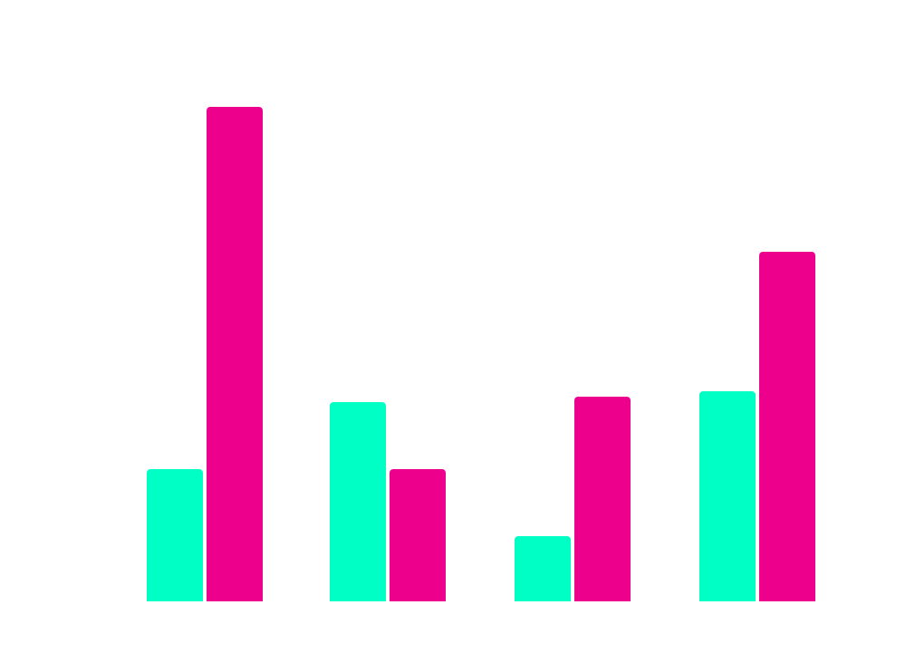
PROGRAMMING LESSON INFOGRAPHICS
Popularity
Venus is the second planet from the Sun
Performance
Despite being red, Mars is a cold place
Follow the link in the graph to modify its data and then paste the new one here. For more info, click here

Slide 14
PROGRAMMING LESSON INFOGRAPHICS
Mercury is the closest planet to the Sun and the smallest one in the Solar System
Innovation
Jupiter is a gas giant and the biggest planet in the entire Solar System
Efficiency
Despite being red, Mars is actually a cold place. It’s full of iron oxide dust
Collaboration

Slide 15

PROGRAMMING LESSON INFOGRAPHICS
25%
75%
Mars
Jupiter
Despite being red, Mars is a very cold place
It is the biggest planet in the Solar System
Follow the link in the graph to modify its data and then paste the new one here. For more info, click here

Slide 16
PROGRAMMING LESSON INFOGRAPHICS
Comparison of programming languages
Performance
Use cases
Trends
Rust
Go
Web
Emerging
Updates
Venus is really hot
Mars is a very cold place
Neptune is far from us
Earth is the Blue Planet
Saturn is a gas giant

Slide 17
PROGRAMMING LESSON INFOGRAPHICS
80%
40%
25%
90%
Mars
Jupiter
Earth
Mercury
Despite being red, Mars is a very cold place
It is the biggest planet in the Solar System
Earth is the only planet with life of them all
Mercury is the smallest planet of them all

Slide 18
PROGRAMMING LESSON INFOGRAPHICS
01
Mercury is the closest planet to the Sun
02
Despite being red, Mars is a cold place
03
Venus is the second planet from the Sun

Slide 19
PROGRAMMING LESSON INFOGRAPHICS
25%
50%
75%
Mercury
Venus
Mars
Mercury is the closest planet to the Sun
Venus is the second planet from the Sun
Mars is actually a very cold place

Slide 20
PROGRAMMING LESSON INFOGRAPHICS
Mercury
The Moon is a satellite
25%
Jupiter is a big planet
Mercury is the closest planet to the Sun and the smallest of them all
50%
The Sun is a satellite
75%
Saturn has several rings
50%
Venus
Neptune is far away from us
35%
Earth is the planet with life
Venus has a beautiful name and is the second planet from the Sun
80%

Slide 21
PROGRAMMING LESSON INFOGRAPHICS
Efficiency
Scalability
Syntax
Mercury is the closest planet to the Sun
Venus is the second planet from the Sun
Earth is the third planet from the Sun
Versatility
Community
Tooling
Despite being red, Mars is actually a cold place
Neptune is the farthest planet from the Sun
Jupiter is the biggest planet of them all

Slide 22
PROGRAMMING LESSON INFOGRAPHICS
01
Venus has a beautiful name, but also high temperatures
05
Mercury is the smallest planet in the entire Solar System
02
Ceres is a planet located in the main asteroid belt
06
The Moon is our planet’s only natural satellite
03
Jupiter is a gas giant and the biggest planet of them all
07
Earth is the third planet from the Sun and harbors life
04
The Sun is the star at the center of the Solar System
08
Saturn is composed mostly of hydrogen and helium

Slide 23
PROGRAMMING LESSON INFOGRAPHICS
Venus
Mars
Venus is the second planet from the Sun
Despite being red, Mars is a cold place
Jupiter
Saturn
Neptune
It’s the biggest planet in the Solar System
Saturn is a gas giant and has rings
It’s the farthest planet from the Sun

Slide 24
PROGRAMMING LESSON INFOGRAPHICS
Mars
Venus is the second planet from the Sun
Mercury
Saturn is a gas giant and has several rings
Despite being red, Mars is a very cold place
Mercury is the smallest planet in the Solar System
Venus
Saturn

Slide 25
PROGRAMMING LESSON INFOGRAPHICS
Earth
Mercury | Mars | Jupiter | Neptune
Mercury is quite a small planet | Despite being red, Mars is a cold place | Jupiter is the biggest planet of them all | Neptune is very far from the Sun

Slide 26
PROGRAMMING LESSON INFOGRAPHICS
Mercury
Mars
01
06
Mercury is the closest planet to the Sun
Despite being red, Mars is a cold planet
Venus
Jupiter
02
05
Venus is the second planet from the Sun
Jupiter is the biggest planet of them all
Earth
Saturn
03
04
Earth is the only planet with life
Saturn was named after a Roman god

Slide 27
PROGRAMMING LESSON INFOGRAPHICS
25%
75%
Mars
Jupiter
Despite being red, Mars is a very cold place
It is the biggest planet in the Solar System

Slide 28
PROGRAMMING LESSON INFOGRAPHICS
Mercury
01
Mercury is the closest planet to the Sun
Neptune is the farthest planet from the Sun
02
Neptune
Saturn
03
Saturn is composed of hydrogen and helium
Jupiter is the biggest planet of them all
04
Jupiter
Mars
05
Despite being red, Mars is actually a cold place

Slide 29
PROGRAMMING LESSON INFOGRAPHICS
Jupiter
Mercury
Jupiter is an enormous planet
Mercury is a very small planet
Mars
Venus
Earth
Mars is actually a very cold place
Venus has a beautiful name
Saturn
Neptune
Saturn is a gas giant and has rings
Neptune is very far from the Sun

Slide 30
PROGRAMMING LESSON INFOGRAPHICS
Venus
Earth
Mercury
Saturn
Mars
Neptune
Jupiter
Sun

Slide 31
PROGRAMMING LESSON INFOGRAPHICS
Jupiter
Neptune
Jupiter is the biggest planet of them all
50%
Neptune is the farthest planet from the Sun
25%
10%
75%
Mercury
Mars
Mercury is the closest planet to the Sun
Despite being red, Mars is a cold place

Slide 32
PROGRAMMING LESSON INFOGRAPHICS
Mercury
Mercury is the closest planet to the Sun
50%
Jupiter
Jupiter is the biggest planet of them all
75%
Venus
Venus is the second planet from the Sun
25%
Mars
Despite being red, Mars is a very cold place
100%

Slide 33
Instructions for use
If you have a free account, in order to use this template, you must credit Slidesgo in your final presentation. Please refer to the next slide to read the instructions for premium users.
As a Free user, you are allowed to:
- Modify this template.
- Use it for both personal and commercial projects.
You are not allowed to:
- Sublicense, sell or rent any of Slidesgo Content (or a modified version of Slidesgo Content).
- Distribute Slidesgo Content unless it has been expressly authorized by Slidesgo.
- Include Slidesgo Content in an online or offline database or file.
- Offer Slidesgo templates (or modified versions of Slidesgo templates) for download.
- Acquire the copyright of Slidesgo Content.
For more information about editing slides, please read our FAQs or visit our blog:
https://slidesgo.com/faqs and https://slidesgo.com/slidesgo-school

Slide 34
Instructions for use (premium users)
As a Premium user, you can use this template without attributing Slidesgo.
You are allowed to:
Modify this template.
Use it for both personal and commercial purposes.
Share this template in an editable format with people who are not part of your team.
You are not allowed to:
Sublicense, sell or rent this Slidesgo Template (or a modified version of this Slidesgo Template).
Distribute this Slidesgo Template (or a modified version of this Slidesgo Template) or include it in a database or in any other product or service that offers downloadable images, icons or presentations that may be subject to distribution or resale.
Use any of the elements that are part of this Slidesgo Template in an isolated and separated way from this Template.
Register any of the elements that are part of this template as a trademark or logo, or register it as a work in an intellectual property registry or similar.
For more information about editing slides, please read our FAQs or visit our blog:
https://slidesgo.com/faqs and https://slidesgo.com/slidesgo-school

Slide 35
Infographics
You can add and edit some infographics to your presentation to present your data in a visual way.
Choose your favourite infographic and insert it in your presentation using Ctrl C + Ctrl V or Cmd C + Cmd V in Mac.
Select one of the parts and ungroup it by right-clicking and choosing “Ungroup”.
Change the color by clicking on the paint bucket.
Then resize the element by clicking and dragging one of the square-shaped points of its bounding box (the cursor should look like a double-headed arrow). Remember to hold Shift while dragging to keep the proportions.
Group the elements again by selecting them, right-clicking and choosing “Group”.
Repeat the steps above with the other parts and when you’re done editing, copy the end result and paste it into your presentation.
Remember to choose the “Keep source formatting” option so that it keeps the design. For more info, please visit our blog.

